Slide 1
An Enquiry on whether the conditions under the Covid-19 Pandemic are conducive to the holding of Free and Fair Local Government Elections in October 2021
Terry Tselane – 29 June 2021

Slide 2
Introduction
The step taken by the Electoral Commission to initiate this enquiry is commendable
The country is in the middle of a pandemic
The restrictions imposed on gatherings will further affect preparations for elections
The Covid-19 infection rates and deaths have skyrocketed
The majority of people who are vulnerable to infection fall within the category of voters
No country in the world has banned gatherings and proceeded to hold elections

Slide 3
What constitutes Free and Fair Elections
This is what the Constitutional Court said about the notion of Free and Fair Elections
“Whether any election can be so characterized must always be assessed in context . Ultimately it involves a value judgement. The following elements can be distilled as being of fundamental importance to the conduct of free and fair elections. First, every person who is entitled to vote should, if possible, be registered to do so. Second, no one who is not entitled to vote should be permitted to do so. Third, insofar as elections have a territorial component, as is the case with municipal elections where candidates are in the first instance elected to represent particular wards, the registration of voters must be undertaken in such a way as to ensure that only voters in that particular area (ward) are registered and permitted to vote. Fourth, the Constitution projects not only the act of voting and the outcome of elections as a candidate and to seek public office.”

Slide 4
What constitutes Free and Fair Elections cont…
In the matter between the Electoral Commission and Aaron Paseka Mhlope and others, this is what the Constitutional Court said:
“The mere existence of the right to vote without proper arrangements for its effective exercise does nothing for a democracy; it is both empty and useless. The right to free and fair elections underlines the importance of the exercise of the right to vote. The requirement that every election should be fair has implications for the way in which the right to vote can be given more substantive content and legitimately exercised. There are important constitutional considerations relevant to the design of an electoral system which include the need to ensure that the election process will be free and fair and that the results will be both credible and accurate.”

Slide 5
What constitutes Free and Fair Elections cont…
In a matter of Njabuliso Robert Mvelase and the African National Congress and others, the Electoral Court found that failure by a voter to exercise a vote because of fear and intimidation can affect a legitimacy of an election. The Imbabazane election results in Ward 3 were as a result nullified.
“ The appellants have provided sworn evidence that a number of prospective voters did not exercise their right to vote essentially out of fear of being assaulted or intimidated. Indeed, the majority of them were intimidated by what they saw near the respective polling stations and by what they had heard. There are more than thirty-five deponents who declared that they would have voted for the second appellant in that particular election. Such allegations of assaults, intimidation, threats and declared intentions are undisputed.”

Slide 6
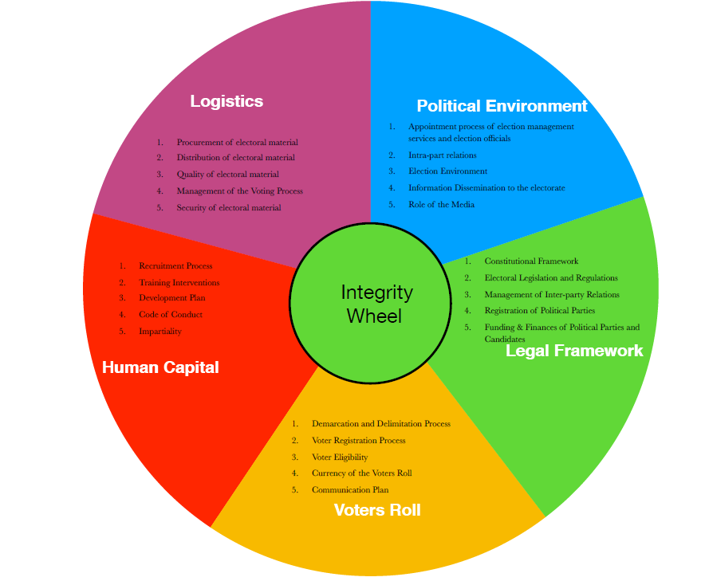
IEMSA’s INTEGRITY WHEEL

Slide 7
IEMSA’s INTEGRITY WHEEL
Political Environment :
Appointment process of election management services and election officials
Intra-party relations
Election Environment
Information Dissemination to the electorate
Role of the Media
Role of State Organs and Incumbency
2. Legal Framework :
Constitutional Framework
Electoral Legislation and Regulations
Management of Inter-party Relations
Registration of Political Parties
Funding & Finances of Political Parties and Candidates

Slide 8
IEMSA’s INTEGRITY WHEEL cont…
3. Voters Roll :
Demarcation and Delimitation Process
Voter Registration Process
Voter Eligibility
Currency of the Voters Roll
Communication Plan
4. Human Capital :
Recruitment Process
Training Interventions
Development Plan
Code of Conduct
Impartiality

Slide 9
IEMSA’s INTEGRITY WHEEL cont…
5. Logistics :
Project Management
Procurement of electoral material
Distribution of electoral material
Management of the Voting Process
Financial & Risk Management
Storage and warehousing of electoral material

Slide 10
Electoral Commission’s Role
Constitutional Framework
In terms of Section 190 of the Constitution of the Republic of South Africa, 1996, the electoral elections commission’s role is to;
Manage elections of National, Provincial and Municipal legislative bodies;
Ensure that those elections are free and fair;
Declare the results of those elections; and
Compile and maintain a voters' roll.
The Electoral Commission has an obligation to ensure free and fair elections;
Free and fair election are, therefore, fundamental in the role of the electoral commission and not accidental to its core functions and mandates
All these three functions are equally important, and none should be elevated above the other.
The fundamental question is whether the commission has satisfied an obligation of an ensuring free and fair elections in its preparations for the 2021 Municipal elections.
It is common cause that the commission has admitted that currently conditions are unfavorable for free and fair elections.

Slide 11
Electoral Commission’s Role cont…
In a matter of the New National Party v Government of Republic of South Africa and Others,
“A prevailing circumstance of some importance is that all people who had a genuine desire to vote would have had to cast their ballot in favour of one or other political party. It must be borne in mind that the responsibility of ensuring that people know of the requirements for voting is not only that of the government. Indispensable to any democratic process is that political parties will ensure that their potential supporters are aware of the prerequisites of voting and comply with them.”

Slide 12
What is the current context?
The country is in the middle of a pandemic
Gatherings have been banned
Political Parties are not able to do their political work as a result.
Citizen’s rights to interact with candidates and Political parties has been limited.
There is real fear and anxiety about this pandemic.
The Commission does not have the resources to conduct two Registration Weekends.
Registration weekend is a key driver of election milestones and election timetable.

Slide 13
Postponing Elections
The legislation anticipates moments when election can be postponed.
Even though the legislation says this must happen within 90-day period, it does not exclude a possibility of having elections outside this period.
There is a precedent where the recent by-elections took place outside a 90 period.
There is no evidence that postponing the election will harm the state of our democracy or offend the Constitution.

Slide 14
Way Forward
Consider postponing the elections to May 2022
The IEC staff and temporary electoral staff should be prioritized for vaccination
ICASA must be drawn in to help political parties to put their messages across to the electorate
Community Radio stations should be supported to help with the interaction between candidates, Political Parties and the Electorate
Prioritise vaccination of the vulnerable groups (the voting population)within the society
Consider postponing the registration earmarked for the weekend of the 17 & 18 July 2021.

